Slide 1
Space Lander
ADJETE ADJEVI P10364658

Slide 2
Concept of the game
The space Lander is a video game in which the player controls a spaceship as it falls towards the surface and he must manoeuvre the ship's thrusters to land safely by avoiding a collision with asteroid around or a touch to the boundaries. the player must adjust the ship's orientation, as well as its horizontal and vertical velocities by using the keyboard arrows such as left, right, up and down keys.
The idea is the spaceship is landing on the moon which in theory has been represented by 800px (pixel) square canvas with red boundary at each side.
Here are the rules that govern the space ship:
At each second, the downward velocity of the ship increase due to the gravity.
It must not touch the any edge of the boundary otherwise it will crash.
The spaceship must avoid the two asteroid represent by one red square and one blue kite.
When the ship make contact with the lunar surface, the descent engine will automatically cut off bear in mind there are some condition to be applied:
If the ship land at a controlled speed on the golden landing pad the game is classified successful
If the ship land inadequately on the landing pad then the game is deemed failure.
And if the ship miss out of landing on the golden pad but instead land on the bottom of the space boundary it is deemed failure as well.

Slide 3
storyboard
Here is the storyboard for the game that is going to be implemented.

Slide 4
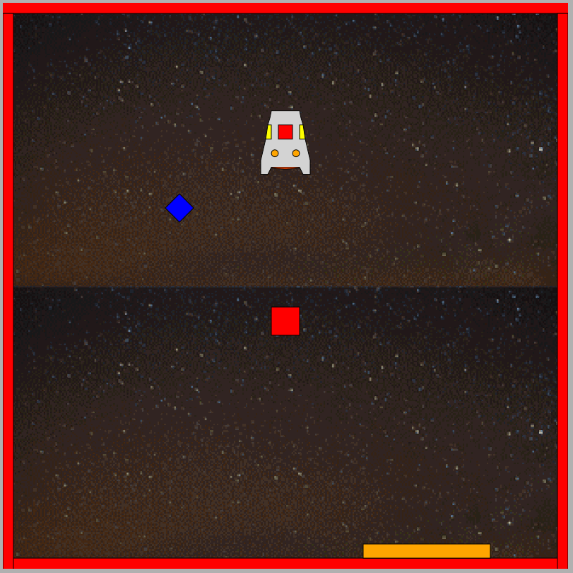
Game start
The ship hovers over the surface
Gravity starts to pull the ship down
Left, Right and Up arrow keys allow application of thrust
Down key cancels all thrust

Slide 5
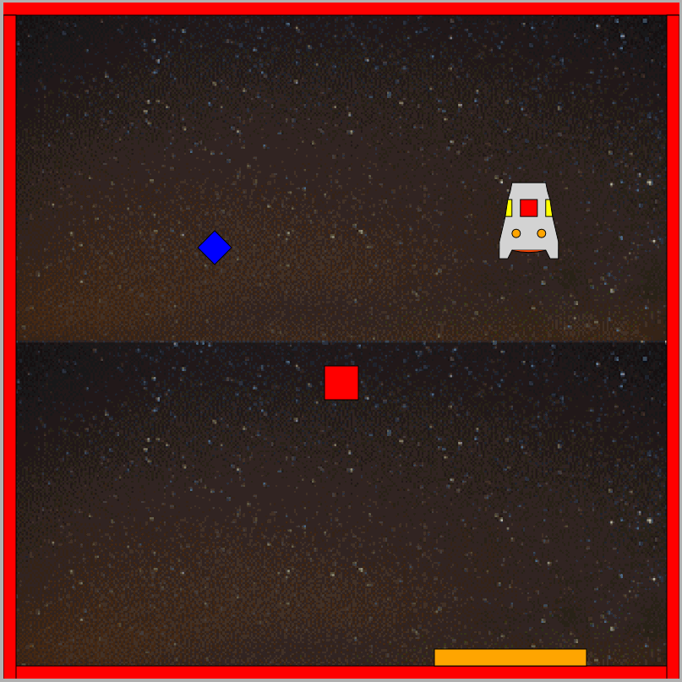
Saucer avoid obstacle by going to right
The ship hovers over the landing pad
Gravity starts to pull the ship down

Slide 6
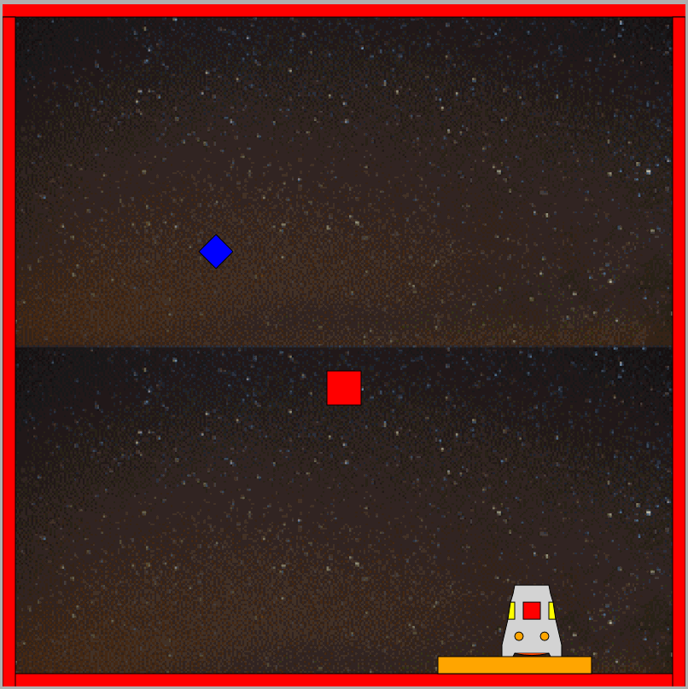
game success
The ship lands successfully on the golden landing pad

Slide 7
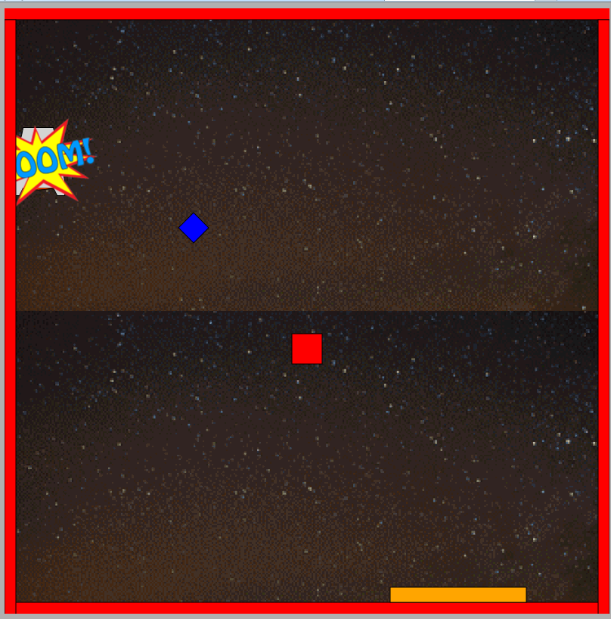
Game failure
The ship hits the left side boundary and explodes due to bad control

Slide 8
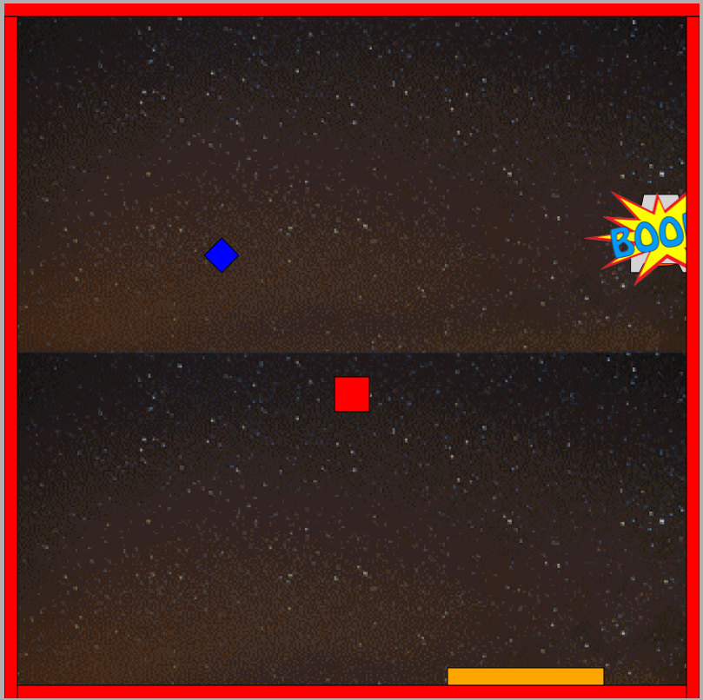
Game failure
The ship hits the right side boundary and explodes due to bad control

Slide 9
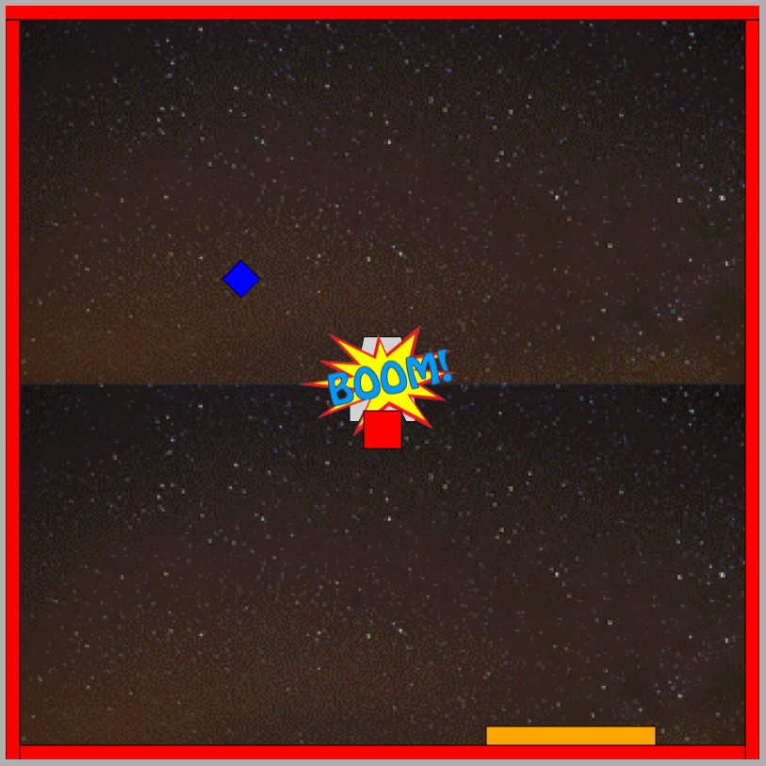
Game failure
The ship hits one of the asteroid and explodes due to bad control

Slide 10
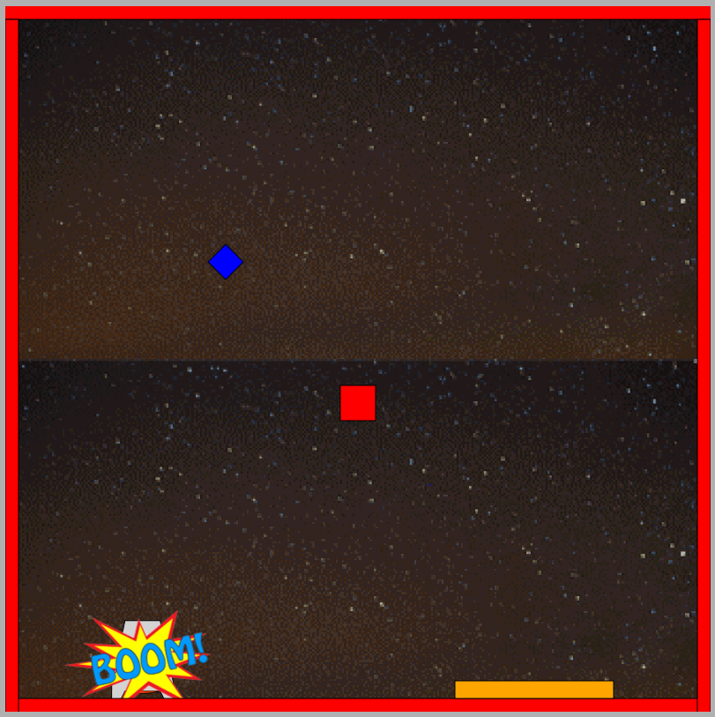
Game failure
The ship hits the bottom side boundary and explodes due to bad control

Slide 11
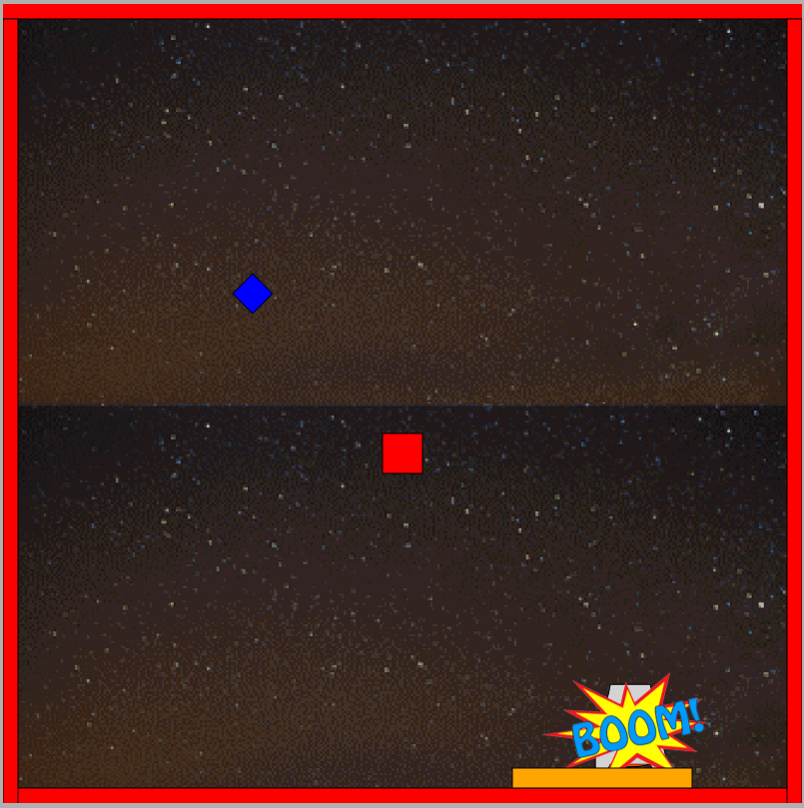
Game failure
The ship explodes due to velocity too high (bad control)

Slide 12
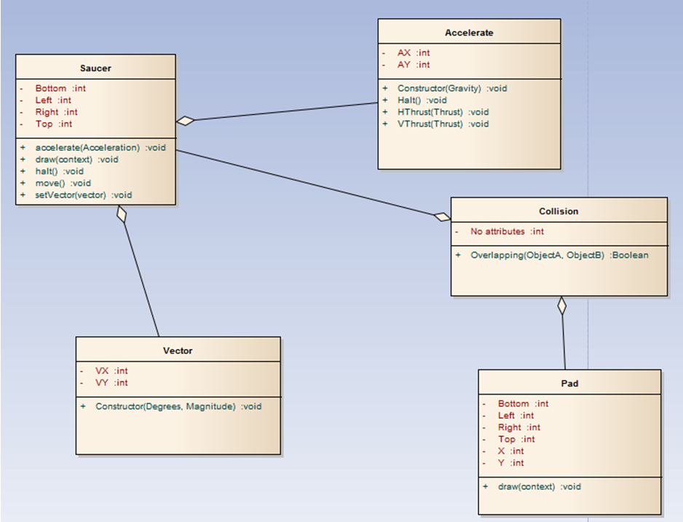
Class diagrams
This is the code aspects of the finishing game illustrate via class diagram which is composed by 5 classes supporting the animation

Slide 13
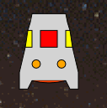

Saucer and the pad
This is the main component of the game call saucer
This is the landing pad showing the outside boundary of the shape

Slide 14
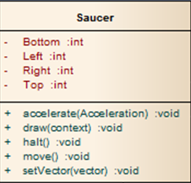
Saucer class methods and attributes
describing its behaviour
The saucer may:
Accelerate
Be drawn
Come to halt
Move
Have a vector applied
It has the following attributes which allow to know the outside boundary of the shape:
Bottom
Left
Right
Top

Slide 15
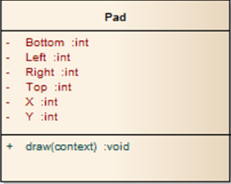
Pad class method and attributes
This landing pas has only one operation allowing it to be drawn
And it supports five attributes :
Bottom
Left
Right
Top
It is also the identifier of the outside edge of the shape:
X
Y

Slide 16
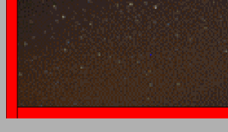
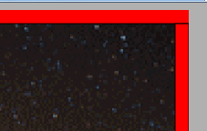
obstacles
These red lines are showing the outside boundaries of the lunar surface

